Slide 1
Meeting -06
Magician Project Update

Slide 2



Project: Magician
Status Update
Meeting -06

Slide 3
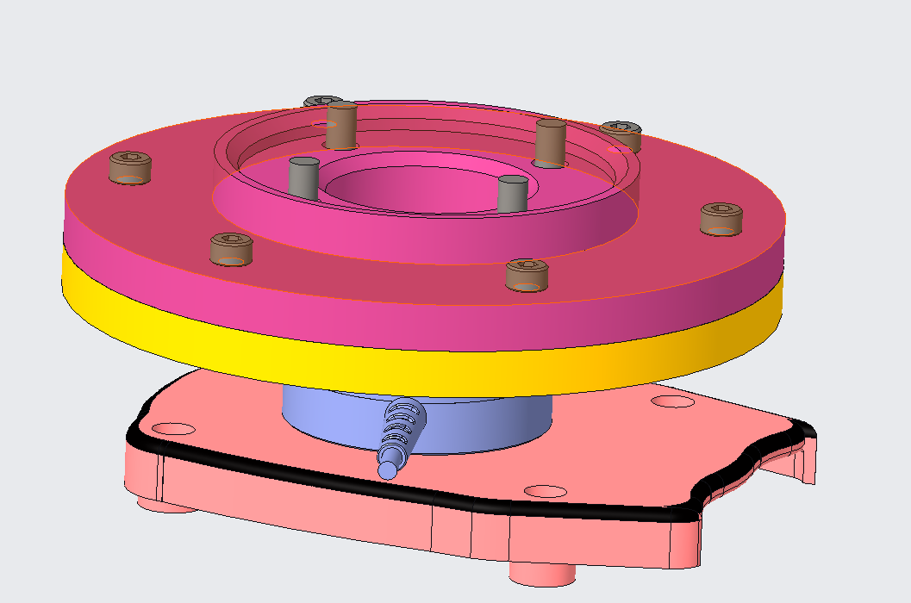
Work Status Update for the Project Magician
Work Status Update for the Project Magician
Design of a direct End effector for gripping Tool
Top flange which will mounted to Doosan
Lower flange which will hold the tool along with the FT sensor.

Slide 4
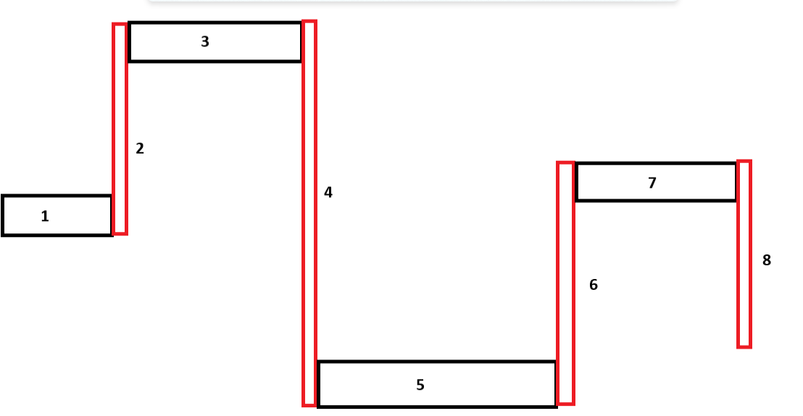
Work Status Update for the Project Magician
Currently doing the designing of the Vibration Isolator for the tool.
As from the earlier data that was obtained earlier results by which in an ideal condition the max forces that will generate when the tool is under operation is between 130-195 Hz.
By knowing the tool’s frequency range and now possible to design the vibration isolator which should not coincide with the above frequency range.
Current Method: Using the folded beams to mitigate the vibrations along the 3 axis

Slide 5
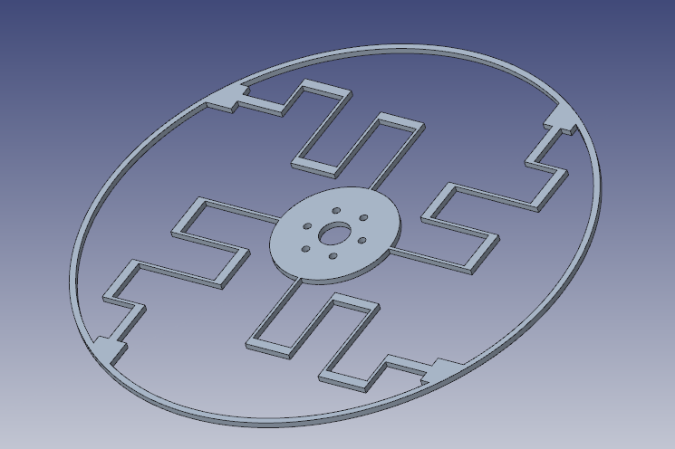
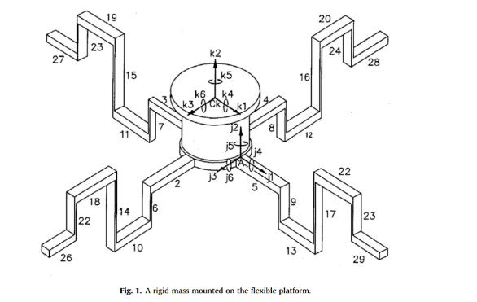
Work Status Update for the Project Magician
Initial design approach
This is the top part that which hold the tool and also isolates the radial forces
This part holds underneath the top part that which isolates the axial loads
Modeling, design and analysis of low frequency platform for attenuating micro-vibration in spacecraft by D. Kamesh et al.,2010.

Slide 6
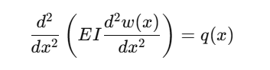
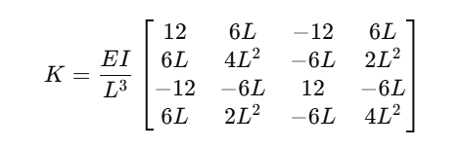
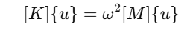
Work Status Update for the Project Magician
Euler Bernoulli beam bending theory
Beam Deflection Equation:
Stiffness Matrix for a Beam Element
Using the Euler-Bernoulli theory, the stiffness matrix for a two-node beam element
Where:
E: Modulus of elasticity (Young's modulus) of the material
I: Second moment of area (moment of inertia) of the beam's cross-section
w(x): Transverse deflection of the beam as a function of xxx
q(x): Distributed load per unit length along the beam
x: Position along the length of the beam
Finding the Natural Frequencies
Are determined by solving the eigenvalue problem
Where:
[K]: Global stiffness matrix assembled from all beam elements.
[M]: Global mass matrix (consistent mass matrix for the beam elements).
ω: Natural angular frequency (ω=2πf, where f is the natural frequency).
{u}: Mode shape vector.

Slide 7
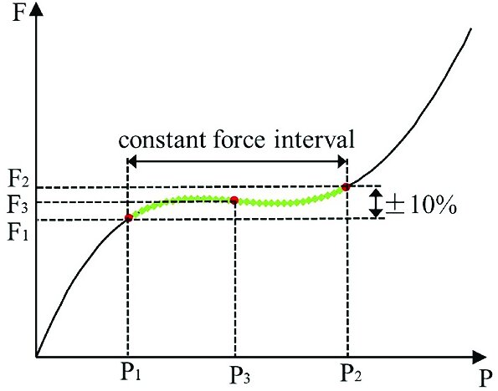
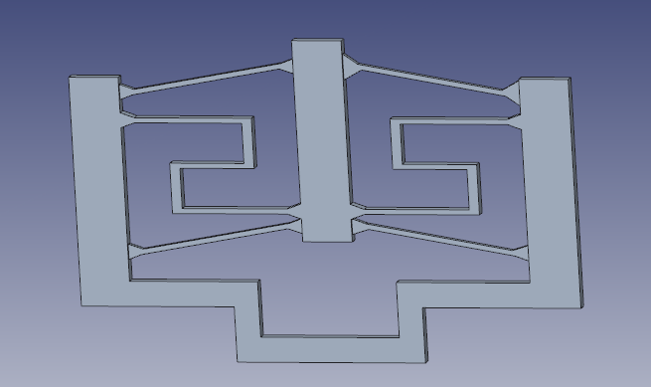
Work Status Update for the Project Magician
Additionally thinking to integrate a Constant force mechanism like this one…
Force
Displacement
Wei, Yuzhang, and Qingsong Xu. "Design of a new passive end-effector based on constant-force mechanism for robotic polishing." Robotics and Computer-Integrated Manufacturing 74 (2022): 102278.

Slide 8
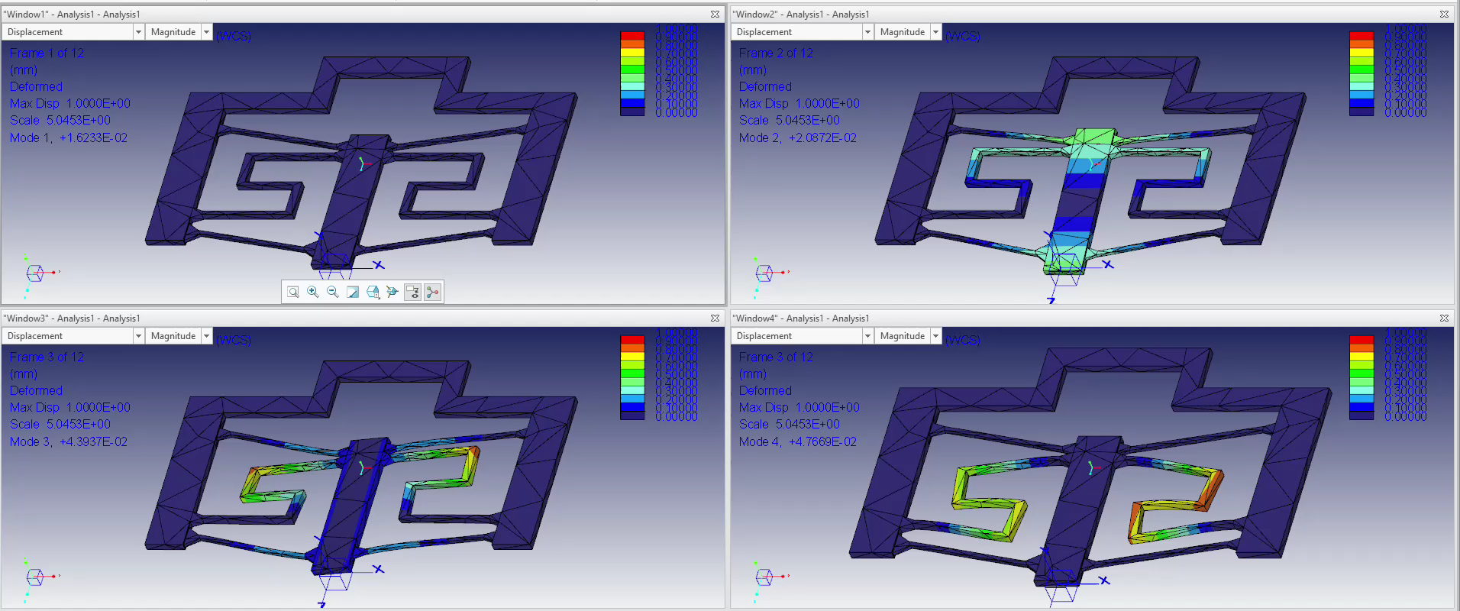
Work Status Update for the Project Magician
Recently conducted some modal analysis and Frequency response analysis in Creo
Modal Analysis Results for a trial model:
Number of Modes: 4
Mode Frequency (Hz)
---- --------------
1 1.623317e-02
2 2.087219e-02
3 4.393663e-02
4 4.766945e-02
Material : AI6061

Slide 9
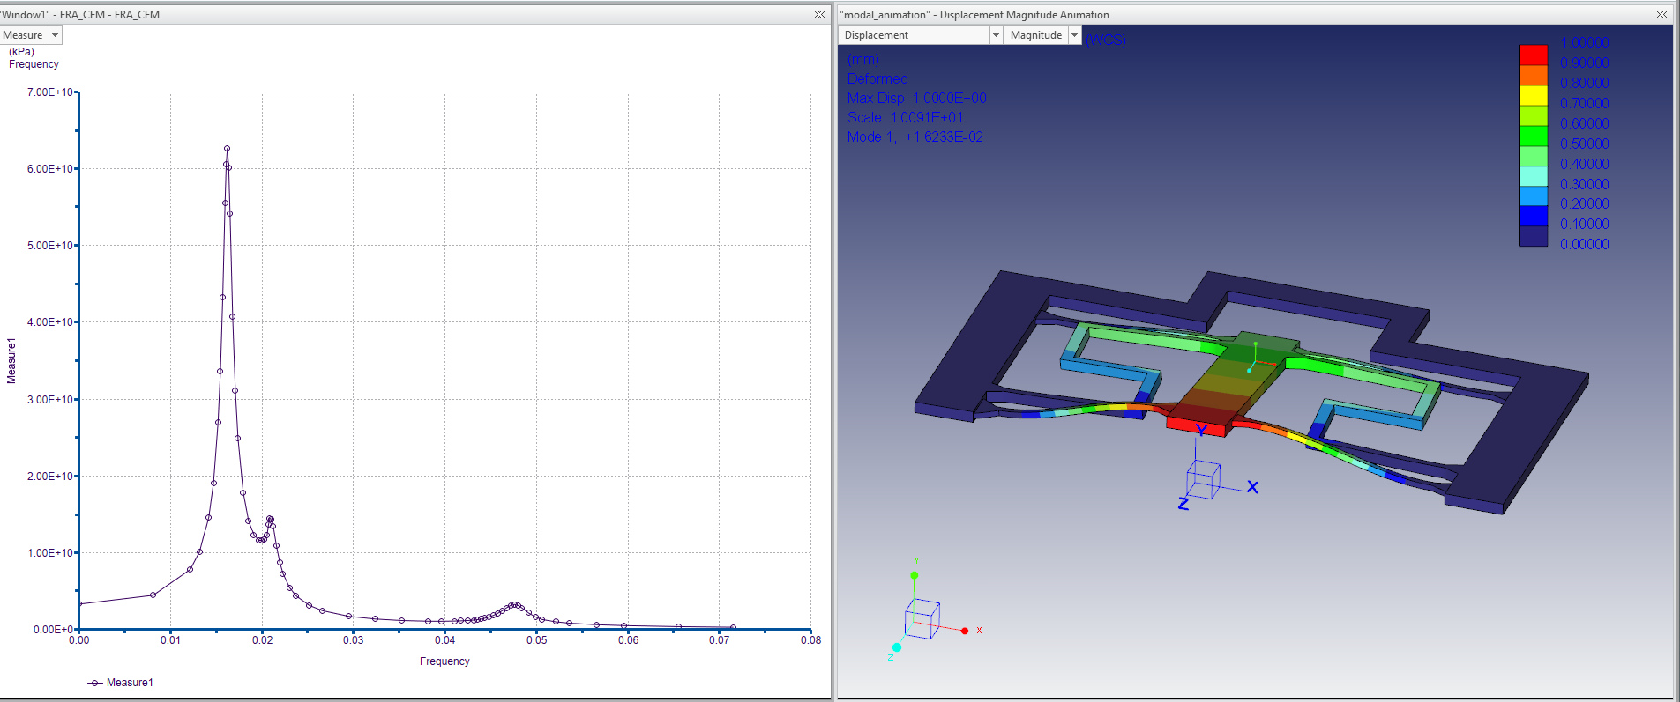
Work Status Update for the Project Magician
Frequency Response Analysis:
From the following graph it is evident that the given system will be having its excitation frequencies in the above mentioned frequencies.

Slide 10
Work Status Update for the Project Magician

Slide 11

Work Status Update for the Project Magician
Thank you very much for your Attention

